Slide 1
Data Mining Project
(- Under the supervision of DR. Bhaskar Biswas)
Human Activity Recognition
Neha Kumari (18074012)
Kumar Shivam Ranjan (18075031)
Madhav Bansal (18075036)

Slide 2
Project Overview
Human Activity Recognition, is the problem of predicting what kind of activity a person is performing based on a signals detected by smartphone sensors on their waist.
Two types of sensors present in smartphones are:
Accelerometer
Gyroscope
Accelerometer measures acceleration and Gyroscope measures angular velocity.

Slide 3
How the data was prepared?
30 volunteers referred to as subjects performed the experiment for data collection wearing smartphones sensors on their waist.
The two smartphone sensors captured the 3 axial linear acceleration as well as the 3 axial angular velocity of the subject.
The sensor signals were sampled in fixed-width sliding windows of 2.56 sec and 50% overlap (128 readings/window).
The data were recorded at the constant frequency of 50Hz (50 data points were recorded each second )

Slide 4
Additional Information
561 feature vector were engineered from each time window of 2.56 second with both time and frequency domain variables
Features are normalized and bounded within [-1,1]
The gyroscopic data is measured in radian/sec
The units used for the accelerations are 'g' (9.8 m/s2)
Accelerometer readings are divided into gravity acceleration and body acceleration readings, which has x,y and z components each.
Gyroscope readings are the measure of angular velocities which has x,y and z components.
Fourier Transforms are made on the above time readings to obtain frequency readings.
Now, on all the base signal readings, mean, std,max, skewness, kurtosis, etc are calculated for each window.

Slide 5
Quick Overview of the Dataset
Data is downloaded from following source:
Human Activity Recognition Using Smartphones Data Set
Feature names are present in UCI_HAR_dataset/features.txt
Train Data
a) UCI_HAR_dataset/train/X_train.txt
b) UCI_HAR_dataset/train/subject_train.txt
c) UCI_HAR_dataset/train/y_train.txt
Test Data
a) UCI_HAR_dataset/test/X_test.txt
b) UCI_HAR_dataset/test/subject_test.txt
c) UCI_HAR_dataset/test/y_test.txt

Slide 6
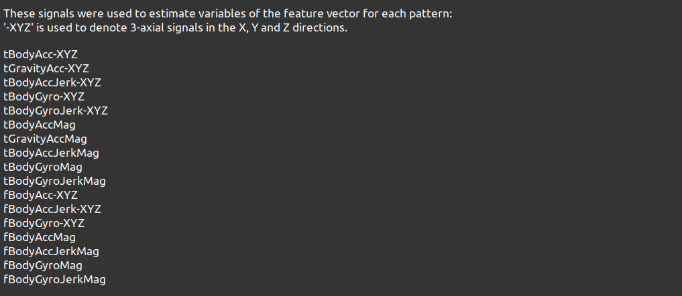
UCI_HAR_dataset/ features_info.txt
Shows information about the variables used on the feature vector

Slide 7
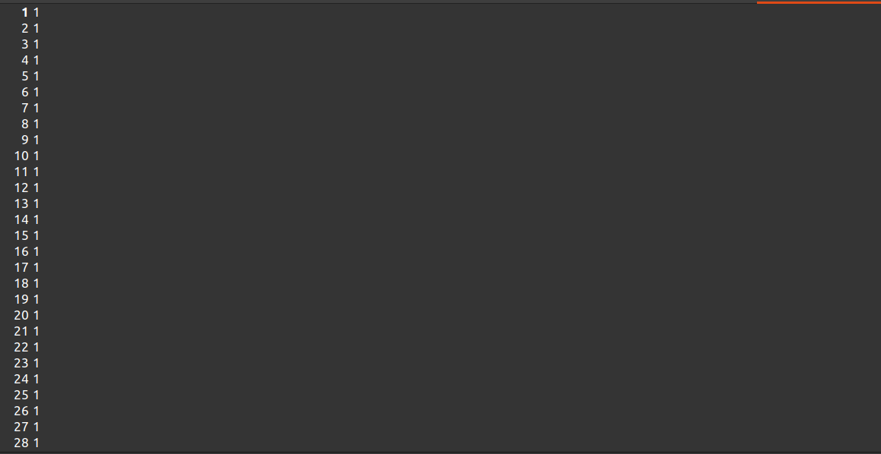
2. UCI_HAR_dataset/train/subject_train.txt
(Each row identifies the subject who performed the activity for each window sample. Its range is from 1 to 30)

Slide 8
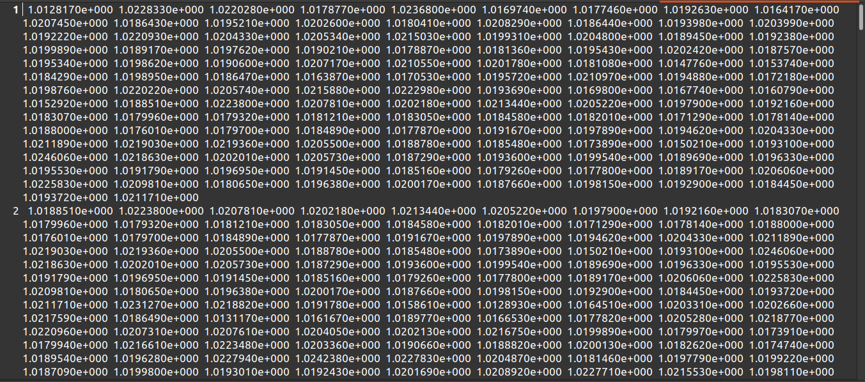
3. UCI_HAR_dataset/train/Inertial Signals/total_acc_x_train.txt
(The acceleration signal from the smartphone accelerometer X axis in standard gravity units 'g'. Every row shows a 128 element vector. The same description applies for the total_acc_x_train.txt and total_acc_z_train.txt files for the Y and Z axis)

Slide 9
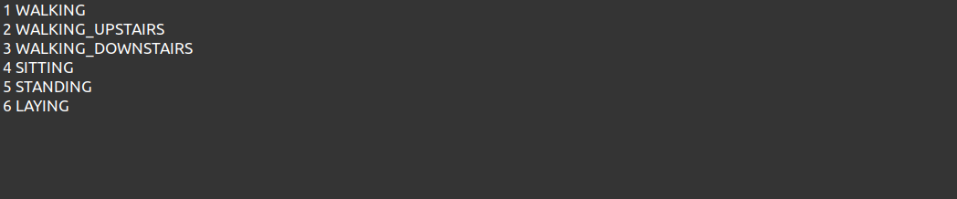
4. UCI_HAR_dataset/activity_labels.txt
Links the class labels with their activity name

Slide 10
Problem Statement
Predict one of the following six activities that a Smartphone user is performing at that 2.56 Seconds time window by using either 561 feature data or raw features of 128 reading.
Walking
Walking Upstairs
Walking Downstairs
Sitting
Standing
Laying

Slide 11
Deep learning model
Accelerometer data was divided into body acceleration and total acceleration (body = total - gravitational force)
The readings from 70% of the volunteers were taken as training data and 30% volunteers records were taken for test data.
We can use LSTM (long short term memory) model of the Recurrent Neural Network (RNN) to recognize various activities of humans like standing, climbing upstairs and downstairs etc.
Why LSTM?
LSTM model is a type of recurrent neural network.It helps us to look at recent information to perform the present task
LSTM works well on time-series data.
This model is used as this helps in remembering values over arbitrary intervals.

Slide 12
Long Short Term Memory Networks
RNNs work better for time series data. Out project data has time window of 2.56 second. In this window, particular volunteer is performing movements like standing ,sitting etc and we are capturing their linear acceleration and angular velocity . RNNs usually handle such time series data very well.
RNNs definitely solve the problem of long term dependencies by using the previous output of the neuron to predict the output of the current neuron but they do suffer serious problems when gap between relevant information and where it is needed become predominantly large.
Moreover,They do suffer from
Vanishing Gradient Problem
Exploding Gradient Problem
That is when LSTMs came into picture.

Slide 13
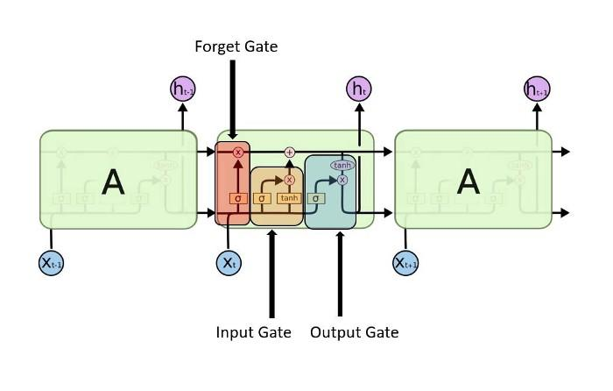
LSTM architecture that will solve HAR problem

Slide 14
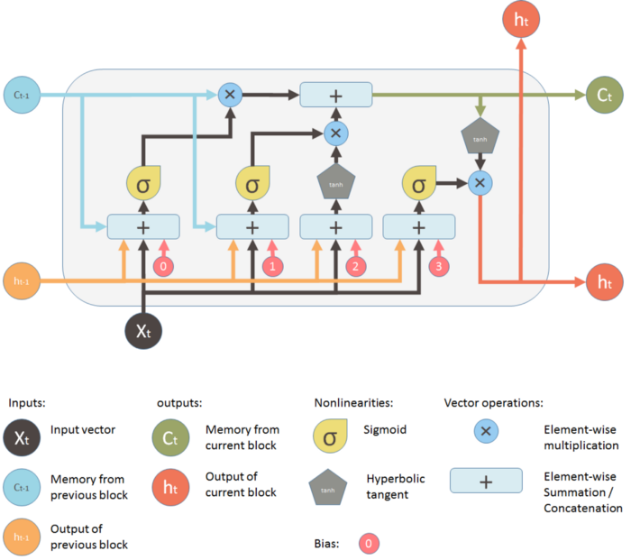
Working of single LSTM neuron

Slide 15
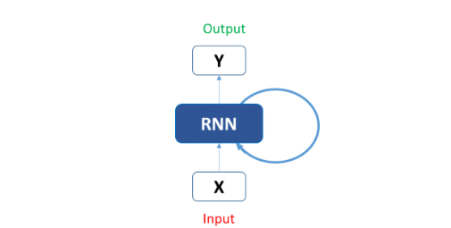
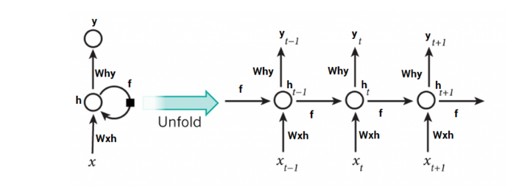
Simpler version of LSTM neuron

Slide 16
Machine learning Model(Logistic Regression)
In Deep learning Model , we used raw features of 128 readings to predict the activity.The Dataset used there was basically a 3D matrix of(7352x128x9).
The Same Dataset cannot be used to train the machine learning model as RNNs are designed to work with time series data not machine learning.
This is why 561 features were engineered from raw 128 accelerometer and gyroscope signal readings so that we can use them in our machine learning model.
We will apply classical Machine Learning models on these 561 sized domain expert engineered features.
As we know that LSTM works well on time-series data, so,we will apply LSTM of Recurrent Neural Networks on 128 sized raw readings that we obtained from accelerometer and gyroscope signals.

Slide 17
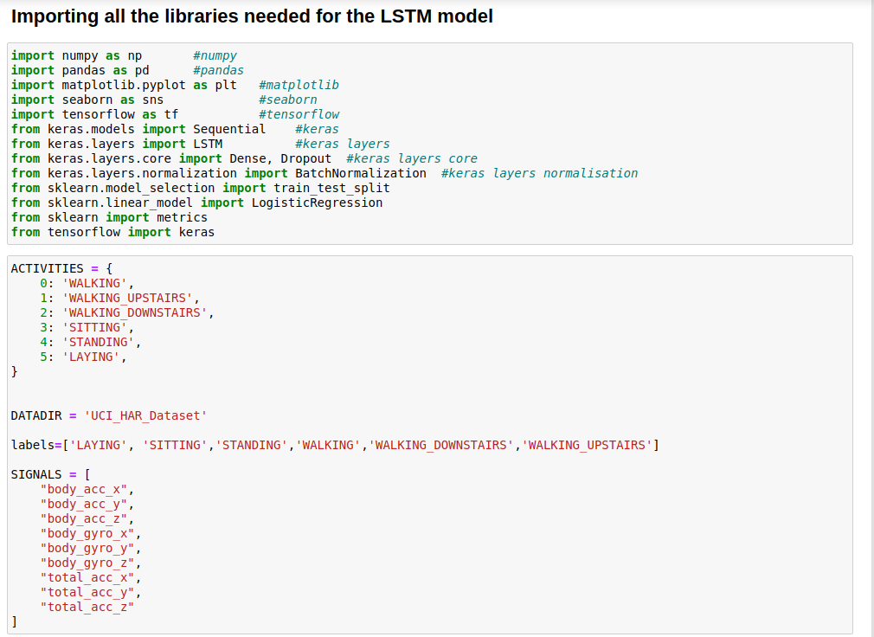

Slide 18
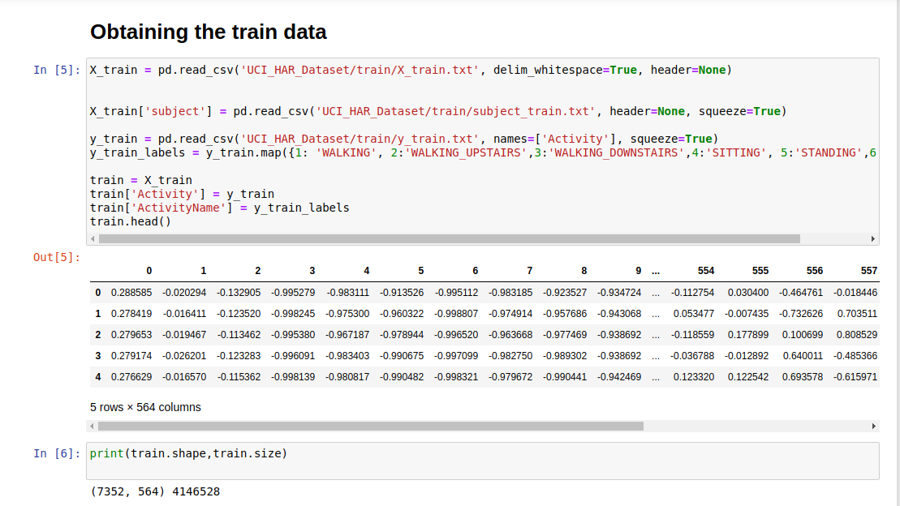

Slide 19
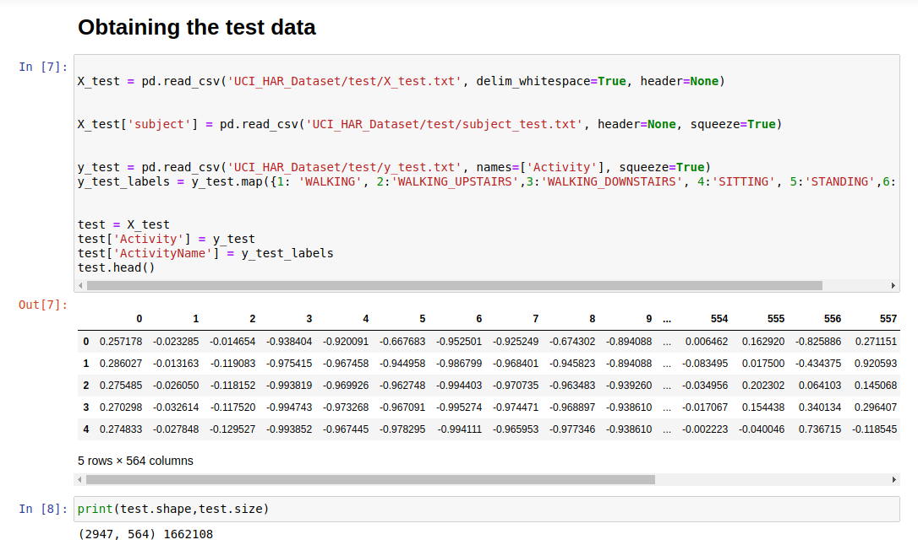

Slide 20
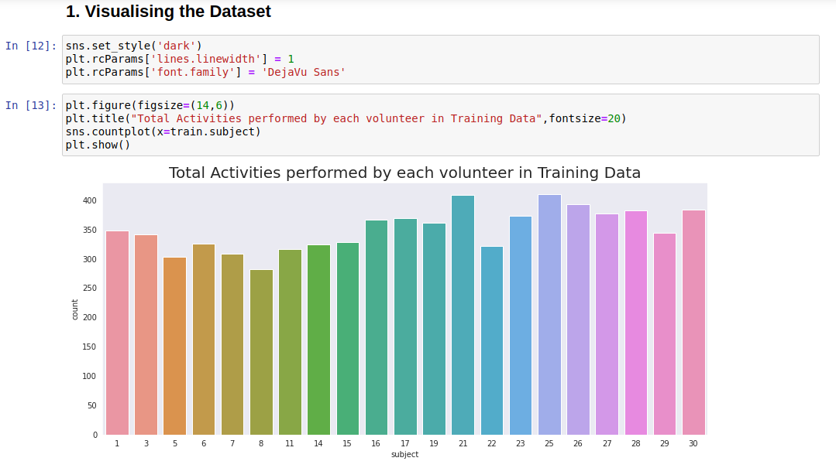

Slide 21
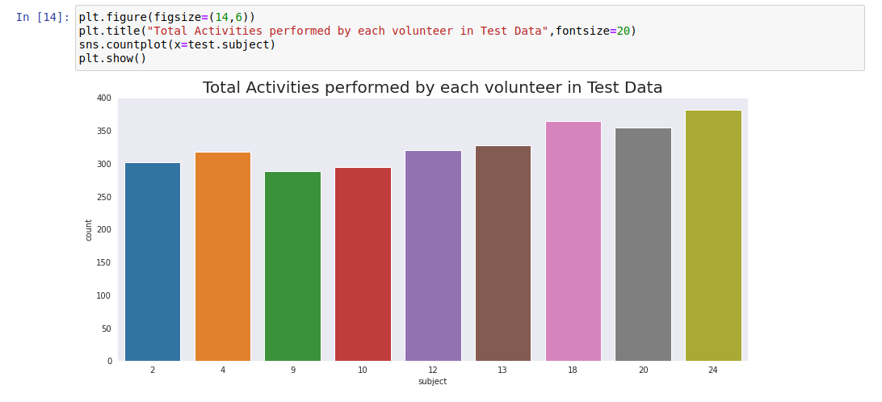

Slide 22
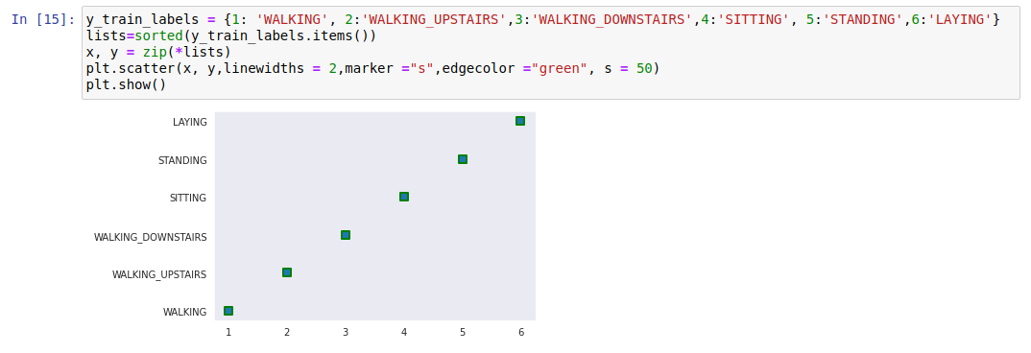

Slide 23
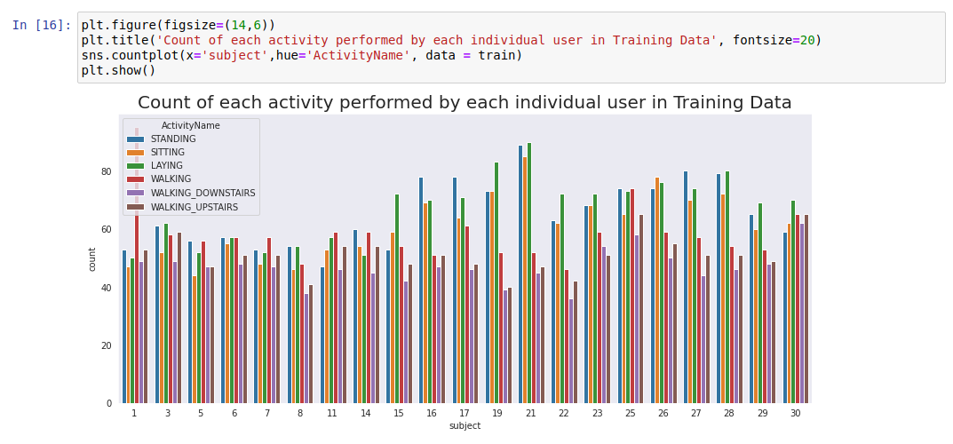

Slide 24
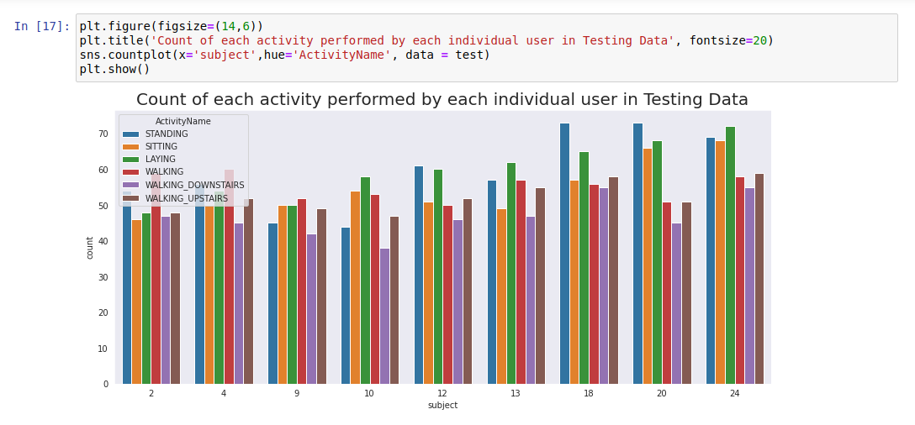

Slide 25
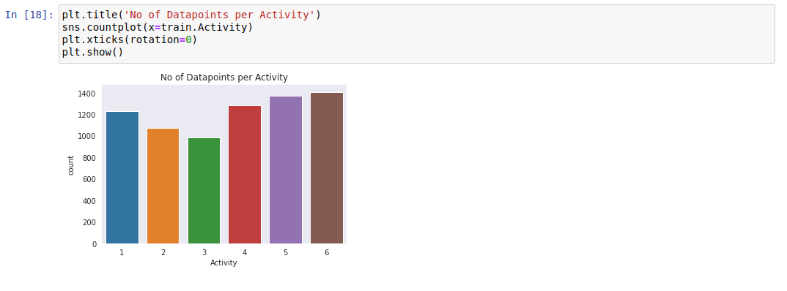

Slide 26
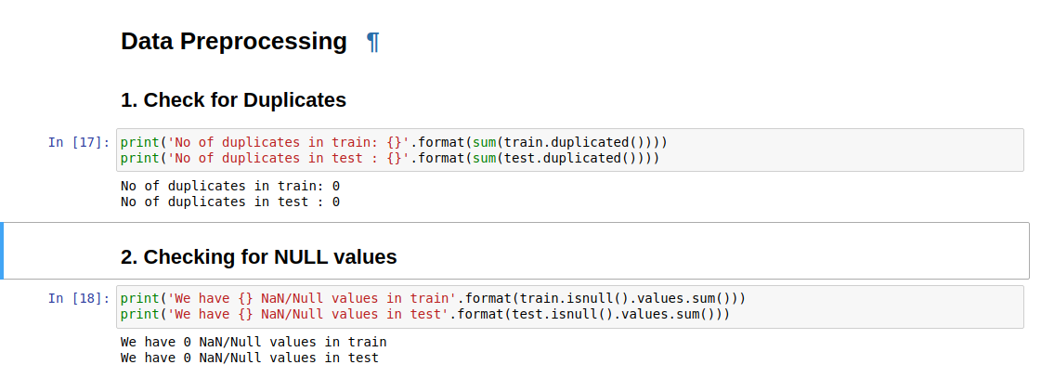

Slide 27
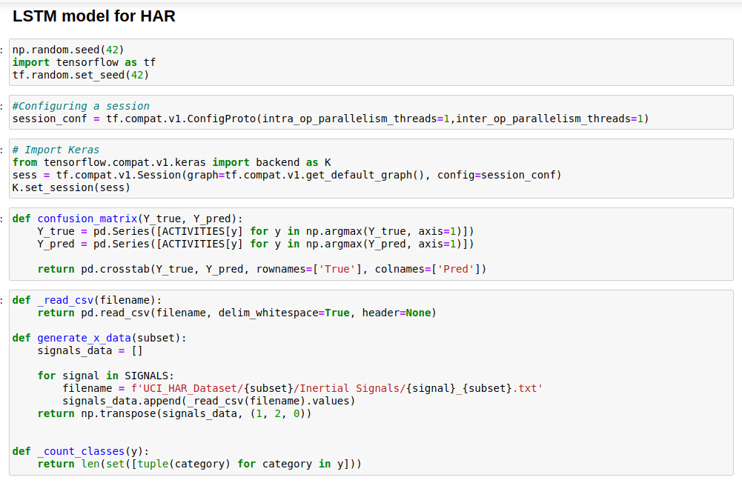

Slide 28
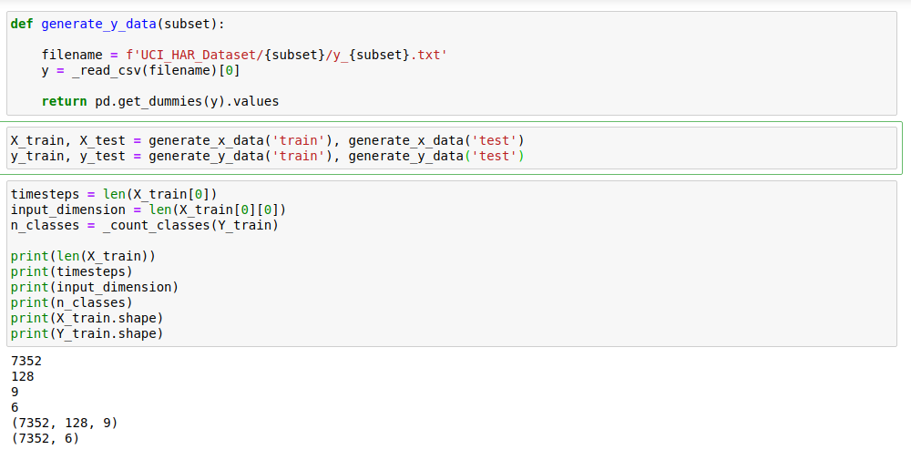

Slide 29
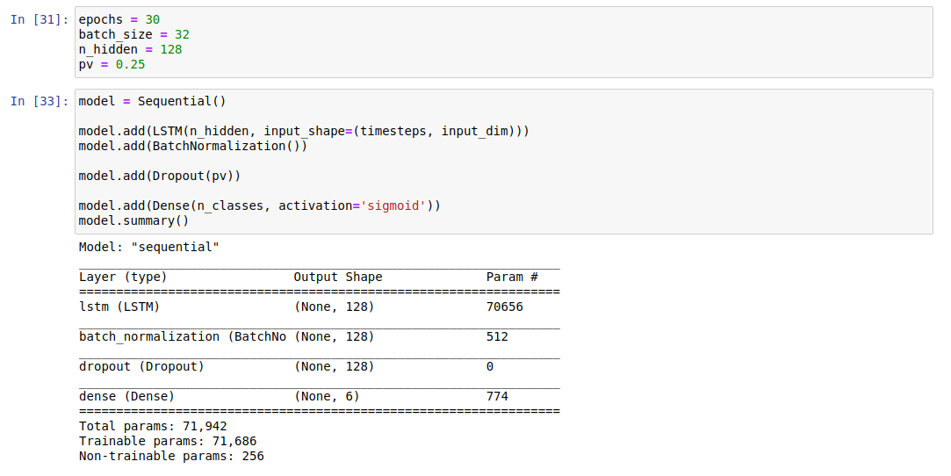

Slide 30
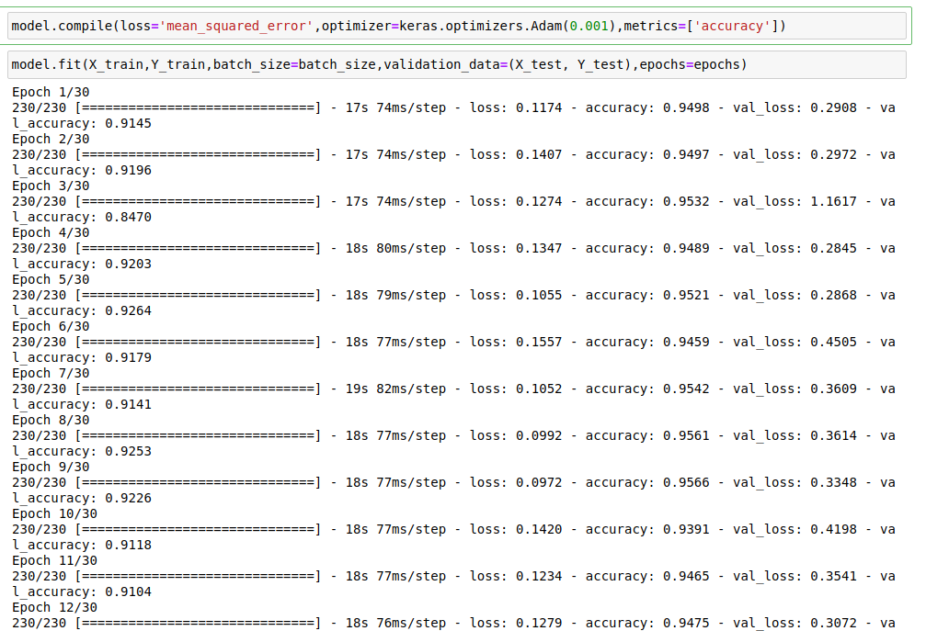

Slide 31
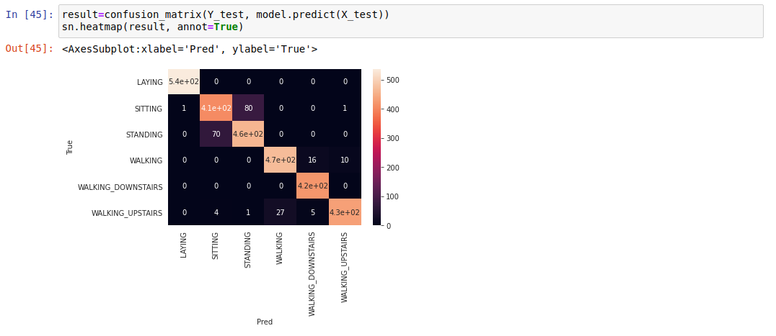

Slide 32
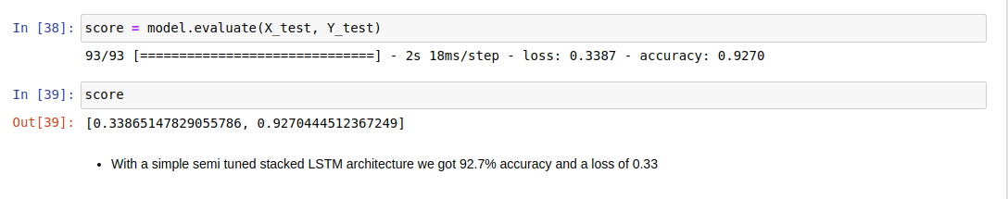

Slide 33
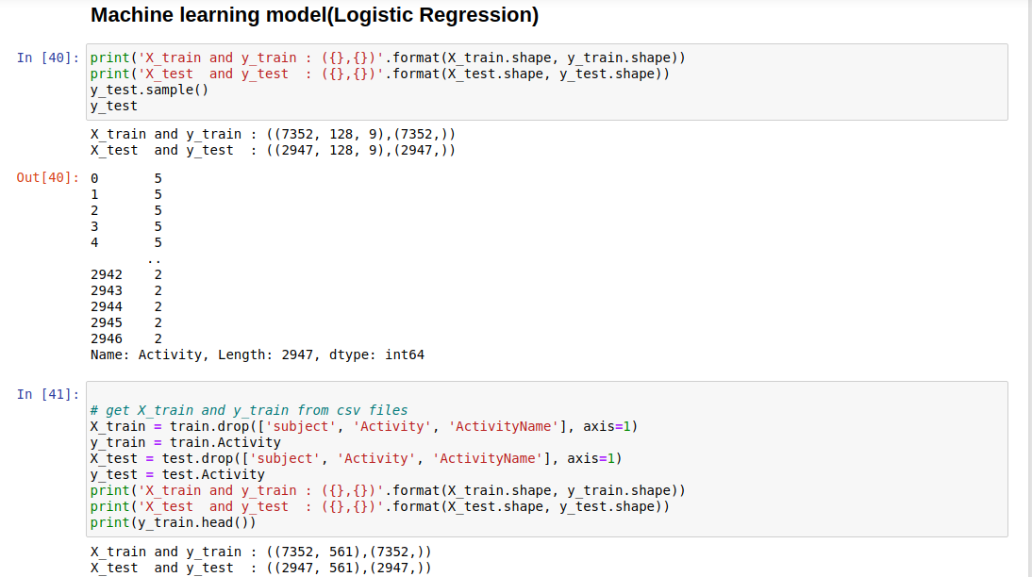

Slide 34
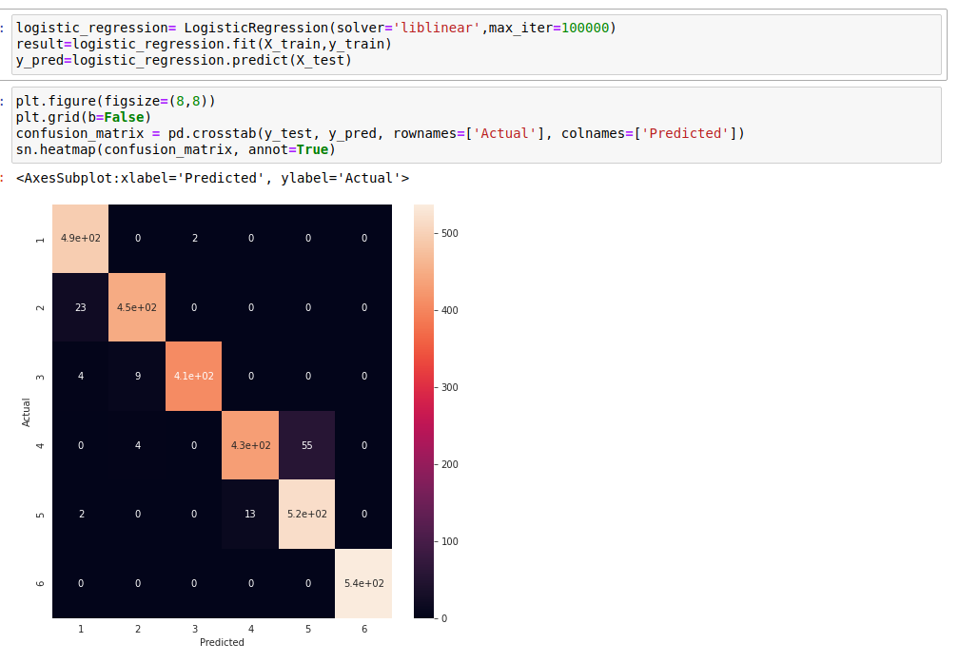

Slide 35
Final Comments:
Model | Accuracy
Machine learning (Logistic Regression) | 96.13%
LSTM Model (Recurrent Neural Network) | 92.70%

Slide 36
Changes on base LSTM model to make it work better
Changes | Result
Increased the number of LSTM layers with corresponding increase in dropout layer | Accuracy dropped to 87%
Changed the loss arguement of compile() from categorical_crossentropy to SparseCategoricalCrossentropy | Accuracy didn’t significantly and remained 87%
Changed the loss arguement of compile() From categorical_crossentropy to mean_squared_error | Accuracy jumped up to 89.9%
Changed the optimiser from ‘rmsprop’ to ‘adam’ | Accuracy jumped up to 91.10%

Slide 37
Thank You

